Slide 1
PDF Knowledge Extraction System with RAG and CAG Models

Slide 2
INDEX
Implementation
1. Data Description
2. Preprocessing steps
Model Implementation
1. Algorithm Definition
2. working Process
3. Results from Algorithm
UML’s
Output Screens
Conclusion
Future Scope
Conclusion
Project Description
Problem Statement
Objective
Scope
Significant
Proposed System
Architecture
Resource Requirements
Research Gap analysis
Literature Review

Slide 3
Project Description
With the digital transformation of information that happened so quickly, there has been an accumulation of PDF documents through which knowledge flows. In this project, a very sturdy PDF Knowledge Extraction System was presented integrating the RAG and CAG models for intelligent and scalable document querying. It permits users to upload PDF files and then these files will be automatically parsed and segmented into chunks of content. Considered two parallel embedding pipelines: one uses Google Gemini 1.5 Flash API to generate high-quality embeddings for RAG model and the other uses HuggingFace models to cache in CAG framework.
Embeddings from both pipelines are kept in two different vector stores using ChromaDB, which guarantees rapid retrieval and response generation. When a query goes in, the system looks into the cache to see if any results are there. In case of a cache hit, an appropriate answer is returned immediately with just some milliseconds of latency. A cache miss presents where the query will be processed via RAG as well as be cached for later requests. This hybridization is mainly for optimized performance since RAG contributes its content awareness while CAG supports excellent efficiency, suitable for knowledge-agent type applications in a wide array of domains.

Slide 4
PROBLEM STATEMENT
Extracting insights from unstructured PDFs remains challenging due to complex structures.
Traditional keyword or rule-based methods fail to capture semantic and contextual meaning.
Current systems struggle with scalability, efficiency, and complex domain-specific queries.
Embedding-based search lacks optimal integration with generative models for dynamic responses.
No efficient caching leads to repeated computations and slower performance.
Lack of unified systems that combine retrieval, generation, and result reuse for improved user experience.

Slide 5
OBJECTIVE OF PROJECT
Primary Goals
Build a scalable system for extracting deep knowledge from large PDF sets.
Use RAG for dynamic retrieval and CAG for caching to improve speed, accuracy, and efficiency.
Overcome current limitations like slow response, poor context handling, and high computation costs.
Specific Aims
PDF Parsing & Chunking
Develop methods to extract and structure PDF content for embedding and semantic search.
RAG + CAG Integration
Combine retrieval and caching to boost query speed and reduce resource usage.
Expected Outcome
A high-performance, low-overhead framework for knowledge extraction from unstructured PDFs.

Slide 6
SCOPE
PDF Document Processing: The study will concern itself with the extraction of text from PDFs and subsequent segmentation of that text into smaller chunks for embedding generation.
Embedding Generation: The study will implement and compare embedding-generating practices using the Gemini 1.5 Flash API of Google and HuggingFace models for further contextual analysis.
RAG and CAG Integration: The system will use RAG for document retrieval and CAG to cache results for frequently retrieved documents to minimize retrieval time and resource consumption.
Query Handling: The framework handles user queries by searching through embedded documents and providing answers contextual to the query.
System Performance: The study will measure the framework's performance with regard to accuracy, response time, and scalability.

Slide 7
SIGNIFICANT
Improved Knowledge Extraction
Enhances the ability to extract meaningful insights from complex, unstructured PDF documents.
Increased Efficiency
Reduces processing time through caching and optimized retrieval techniques.
Better Accuracy in Responses
Combines retrieval and generation models (RAG + CAG) to deliver more contextually accurate answers.
Scalability for Large Document Sets
Enables handling of vast PDF collections with minimal computational overhead.
Cross-Industry Applicability
Provides a reusable framework for sectors like legal, healthcare, research, and finance.

Slide 8
EXISTING SYSTEM
Keyword-based and rule-based methods dominate current PDF processing tools.
These systems lack semantic understanding and often miss contextual information.
Embedding-based retrieval is emerging but struggles with complex, domain-specific queries.
Most systems do not integrate advanced generative models like RAG or CAG.
No efficient caching, leading to repeated processing and slower performance.

Slide 9
PROPOSED SYSTEM
Integrates RAG (Retrieval-Augmented Generation) for dynamic, context-aware document retrieval.
Uses CAG (Caching-Augmented Generation) to store and reuse previous query results, improving speed and efficiency.
Implements a robust PDF parsing and chunking framework for better embedding and search.
Supports semantic search and contextual question answering across large document sets.
Designed to be scalable, fast, and accurate, with lower computational overhead.

Slide 10
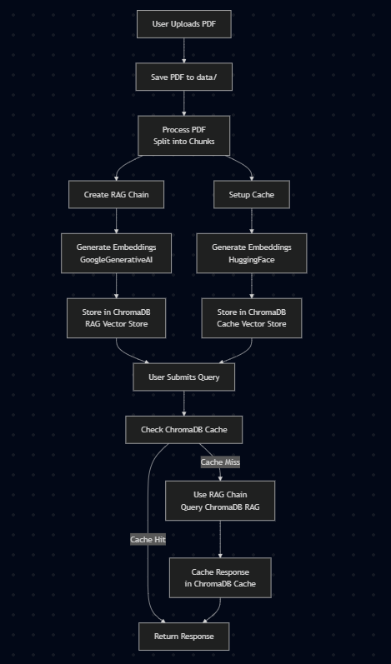
ARCHITECHTURE DIAGRAM

Slide 11
Resource Requirements
01
Hardware
(Processor: I5/Intel Processor, RAM: 8GB (min), Hard Disk: 128 GB, Key Board: Standard Windows Keyboard, Mouse: Two or Three Button Mouse)
Resources
02
Software
(Operating System: Windows 10, Programming Language: Python 3.10.8, IDE: VS Code)
03
Packages/Libraries
(Streamlit, Sklearn, Transformers, Tensorflow, Pandas, Seaborn, Speech Recognition

Slide 12
RESEARCH GAP ANALYSIS
Multi-Modal Integration: Most of the systems are still text-based extraction systems and cannot handle multi-modal documents where one can have a mixture of text, images, and tables. This is especially pertinent in scientific research, healthcare, and law situations where other more complex documents require a further level of integration between various data types.
Efficient Real-Time Knowledge Extraction: Models like BERT and GPT excel at document retrieval but are very resource heavy, thus discouraging, to say the least, their application in real-time for large-scale settings. Efficient models are those expected to work well under real-time conditions.
Application-Specific Solutions: Another less explored area in the field of knowledge extraction systems is application-specific domain use cases. In fact, adapting such models for the peculiarities of legal documents, medical documents, or scientific documents greatly increases the possibility of extracting much finer actionable knowledge.

Slide 13
LITERATURE SURVEY
S.NO | YEAR | AUTHORS | TITLE | OUT COMES
1 | 2025 | Constantino et al. | Representing the Disciplinary Structure of Physics: A Comparative Evaluation of Graph and Text Embedding Methods | Evaluated graph and text embeddings for representing the disciplinary structure of physics, highlighting the effectiveness of neural network-based methods over traditional ones.
2 | 2014 | Pennington et al. | GloVe: Global Vectors for Word Representation | Introduced GloVe, an unsupervised learning algorithm for obtaining vector representations for words, capturing global word-word co-occurrence statistics from a corpus.

Slide 14
LITERATURE SURVEY
S.NO | YEAR | AUTHORS | TITLE | OUT COMES
3 | 2017 | Cer et al. | SemEval-2017 Task 1: Semantic Textual Similarity Multilingual and Crosslingual Focused Evaluation | Assessed semantic textual similarity across multiple languages, providing insights into multilingual and cross-lingual semantic understanding.
4 | 2025 | Moskvoretskii et al. | Adaptive Retrieval Without Self-Knowledge? Bringing Uncertainty Back Home | Analyzed 35 adaptive retrieval methods and 27 uncertainty estimation techniques, showing that uncertainty estimation often outperforms complex pipelines in terms of efficiency and self-knowledge, while maintaining comparable QA performance.

Slide 15
IMPLEMENTATION
01
04
Data Description
Working Process
02
Preprocessing steps
03
05
Algorithm Definition
Results from Algorithm

Slide 16
DATA DESCRIPTION:
Data Sources
Public PDFs from ResearchGate, arXiv, Project Gutenberg, and government sites.
Covers various domains: research, legal, business, and literature.
Tools Used
PDF Parsing: PyMuPDF, pdfplumber
Embeddings: Gemini 1.5 Flash, HuggingFace
Storage: ChromaDB
Querying: RAG-based models
Testing: Pytest for performance metrics

Slide 17
PRE-PROCESSING STEPS
PDF Text Extraction
Extract raw text from PDFs using libraries like PyMuPDF or pdfplumber.
Text Cleaning
Remove unwanted characters, headers, footers, and irrelevant metadata.
Segmentation & Chunking
Break text into meaningful chunks or sections for better embedding.
Normalization
Convert text to lowercase, remove stopwords, and perform stemming or lemmatization.
Embedding Preparation
Prepare cleaned chunks for embedding generation (e.g., vectorization).
Indexing
Store embeddings in a vector database like ChromaDB for efficient retrieval.

Slide 18
METHODOLOGY
Overview of Models Employed
Development of an Intelligent PDF Knowledge Extraction System using two advanced models:
Retrieval-Augmented Generation (RAG)
Cache-Augmented Generation (CAG)
Aim: Extract contextually relevant information and optimize querying for large document sets.
Key Components
RAG Model
Retrieves relevant documents or chunks via embedding search in ChromaDB.
Uses a generative model to produce contextually coherent answers from retrieved data.
CAG Model
Enhances RAG by caching answers for frequent queries.
Returns cached answers immediately to reduce latency and avoid repeated retrieval.

Slide 19
METHODOLOGY
Embedding Generation
Utilizes Google Gemini 1.5 Flash API and HuggingFace pre-trained models.
Generates high-quality vector embeddings of document content.
Embeddings stored in ChromaDB for fast access by RAG and CAG.
Algorithms and Systems Used
RAG Model:
Uses nearest neighbor search (cosine similarity or similar) in embedding space for retrieval.
Employs transformer-based models (e.g., GPT-3) for answer generation.
CAG Model:
Implements Least Recently Used (LRU) cache eviction to keep frequently accessed results.
Embedding Generation:
Semantic vectors created via Google Gemini API.
HuggingFace models accelerate caching and context analysis.
ChromaDB indexes and stores embeddings for optimized retrieval speed.

Slide 20
METHODOLOGY
Interactions Between Components
User Query → Query Preprocessing → Embedding Generation: The user query is preprocessed and then converted into an embedding.
Query Embedding → Document Vector Store (ChromaDB): The query embedding is compared against the stored document embeddings to identify the most relevant sections of the document.
Document Retrieval → RAG Model → Answer Generation: The relevant documents are passed to the RAG model, which generates an answer.
Cache Lookup → CAG Model: If the query has been made previously, the CAG model checks the cache and retrieves the precomputed answer for faster response time.
Answer → Post-Processing → Response Delivery: The answer is processed and delivered back to the user.

Slide 21
RESULTS FROM ALGORITHM
The PDF Knowledge Extraction System results have shown that the system optimally faces semantic document retrieval and question answering with little latency. The more meaningful findings included the following:
CAG Efficiency:
While ensuring that the CAG mechanism was viable for response time reduction, it particularly excelled with respect to frequently repeated queries, attaining a high cache hit rate of 80% and raising speed in turns of response times by roughly five-fold for cache hits from 800 ms to 200 ms. Hence, it is evident that caching mechanism performs well on queries posed in real-world situations, characterized by high-frequency rates.
Ambiguous Queries Issues:
However, with some difficulty, the system attended to questions that were highly ambiguous and required consideration of context between document sections, as well as those requiring detailed synthesis across various sections of the documents. This will be an area for future improvements through better contextual understanding features or via additional mechanisms to handle query refinement.

Slide 22
RESULTS FROM ALGORITHM
Significance of the Findings
The findings of this study are of vital importance to the ever-expanding body of research on semantic document retrieval and answering questions pertaining to the documents. More specifically:
Efficiency of Embedding-Based Search:
This system offers a much more efficient and scalable alternative to traditional keyword-based search methods through the use of embedding-based search and the CAG mechanism, particularly for complex queries demanding deep semantic understanding of the content.
Enhanced User Experience:
As the user satisfaction ratings indicate, semantic models aided by user-centric design can significantly increase the total quality of knowledge extraction systems. The finding goes with the present literature focusing on user experience in intelligent systems, which insists that technology must not only be made powerful but very simple to use.

Slide 23
UML DIAGRAMS
Use Case Diagram: A use case diagram in the Unified Modeling Language (UML) is a type of behavioral diagram defined by and created from a Use-case analysis. Its purpose is to present a graphical overview of the functionality provided by a system in terms of actors, their goals (represented as use cases), and any dependencies between those use cases. The main purpose of a use case diagram is to show what system functions are performed for which actor. Roles of the actors in the system can be depicted.

Slide 24
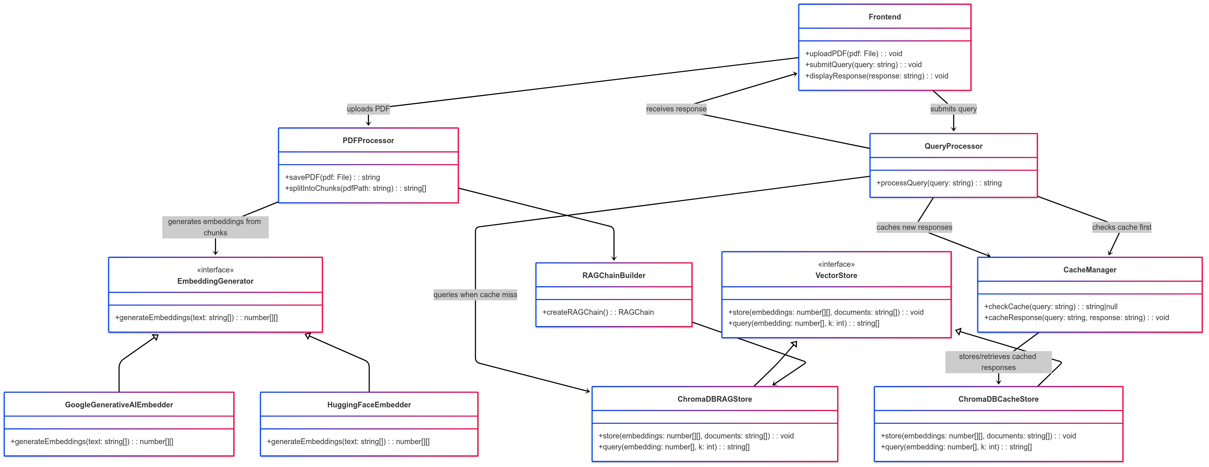
UML DIAGRAMS

Slide 25
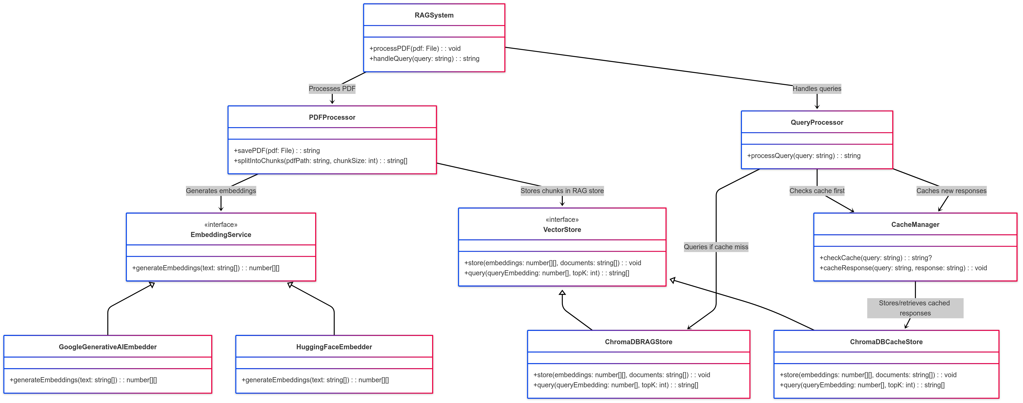
UML DIAGRAMS
Class Diagram:
In software engineering, a class diagram in the Unified Modelling Language (UML) is a type of static structure diagram that describes the structure of a system by showing the system's classes, their attributes, operations (or methods), and the relationships among the classes. It explains which class contains information.

Slide 26
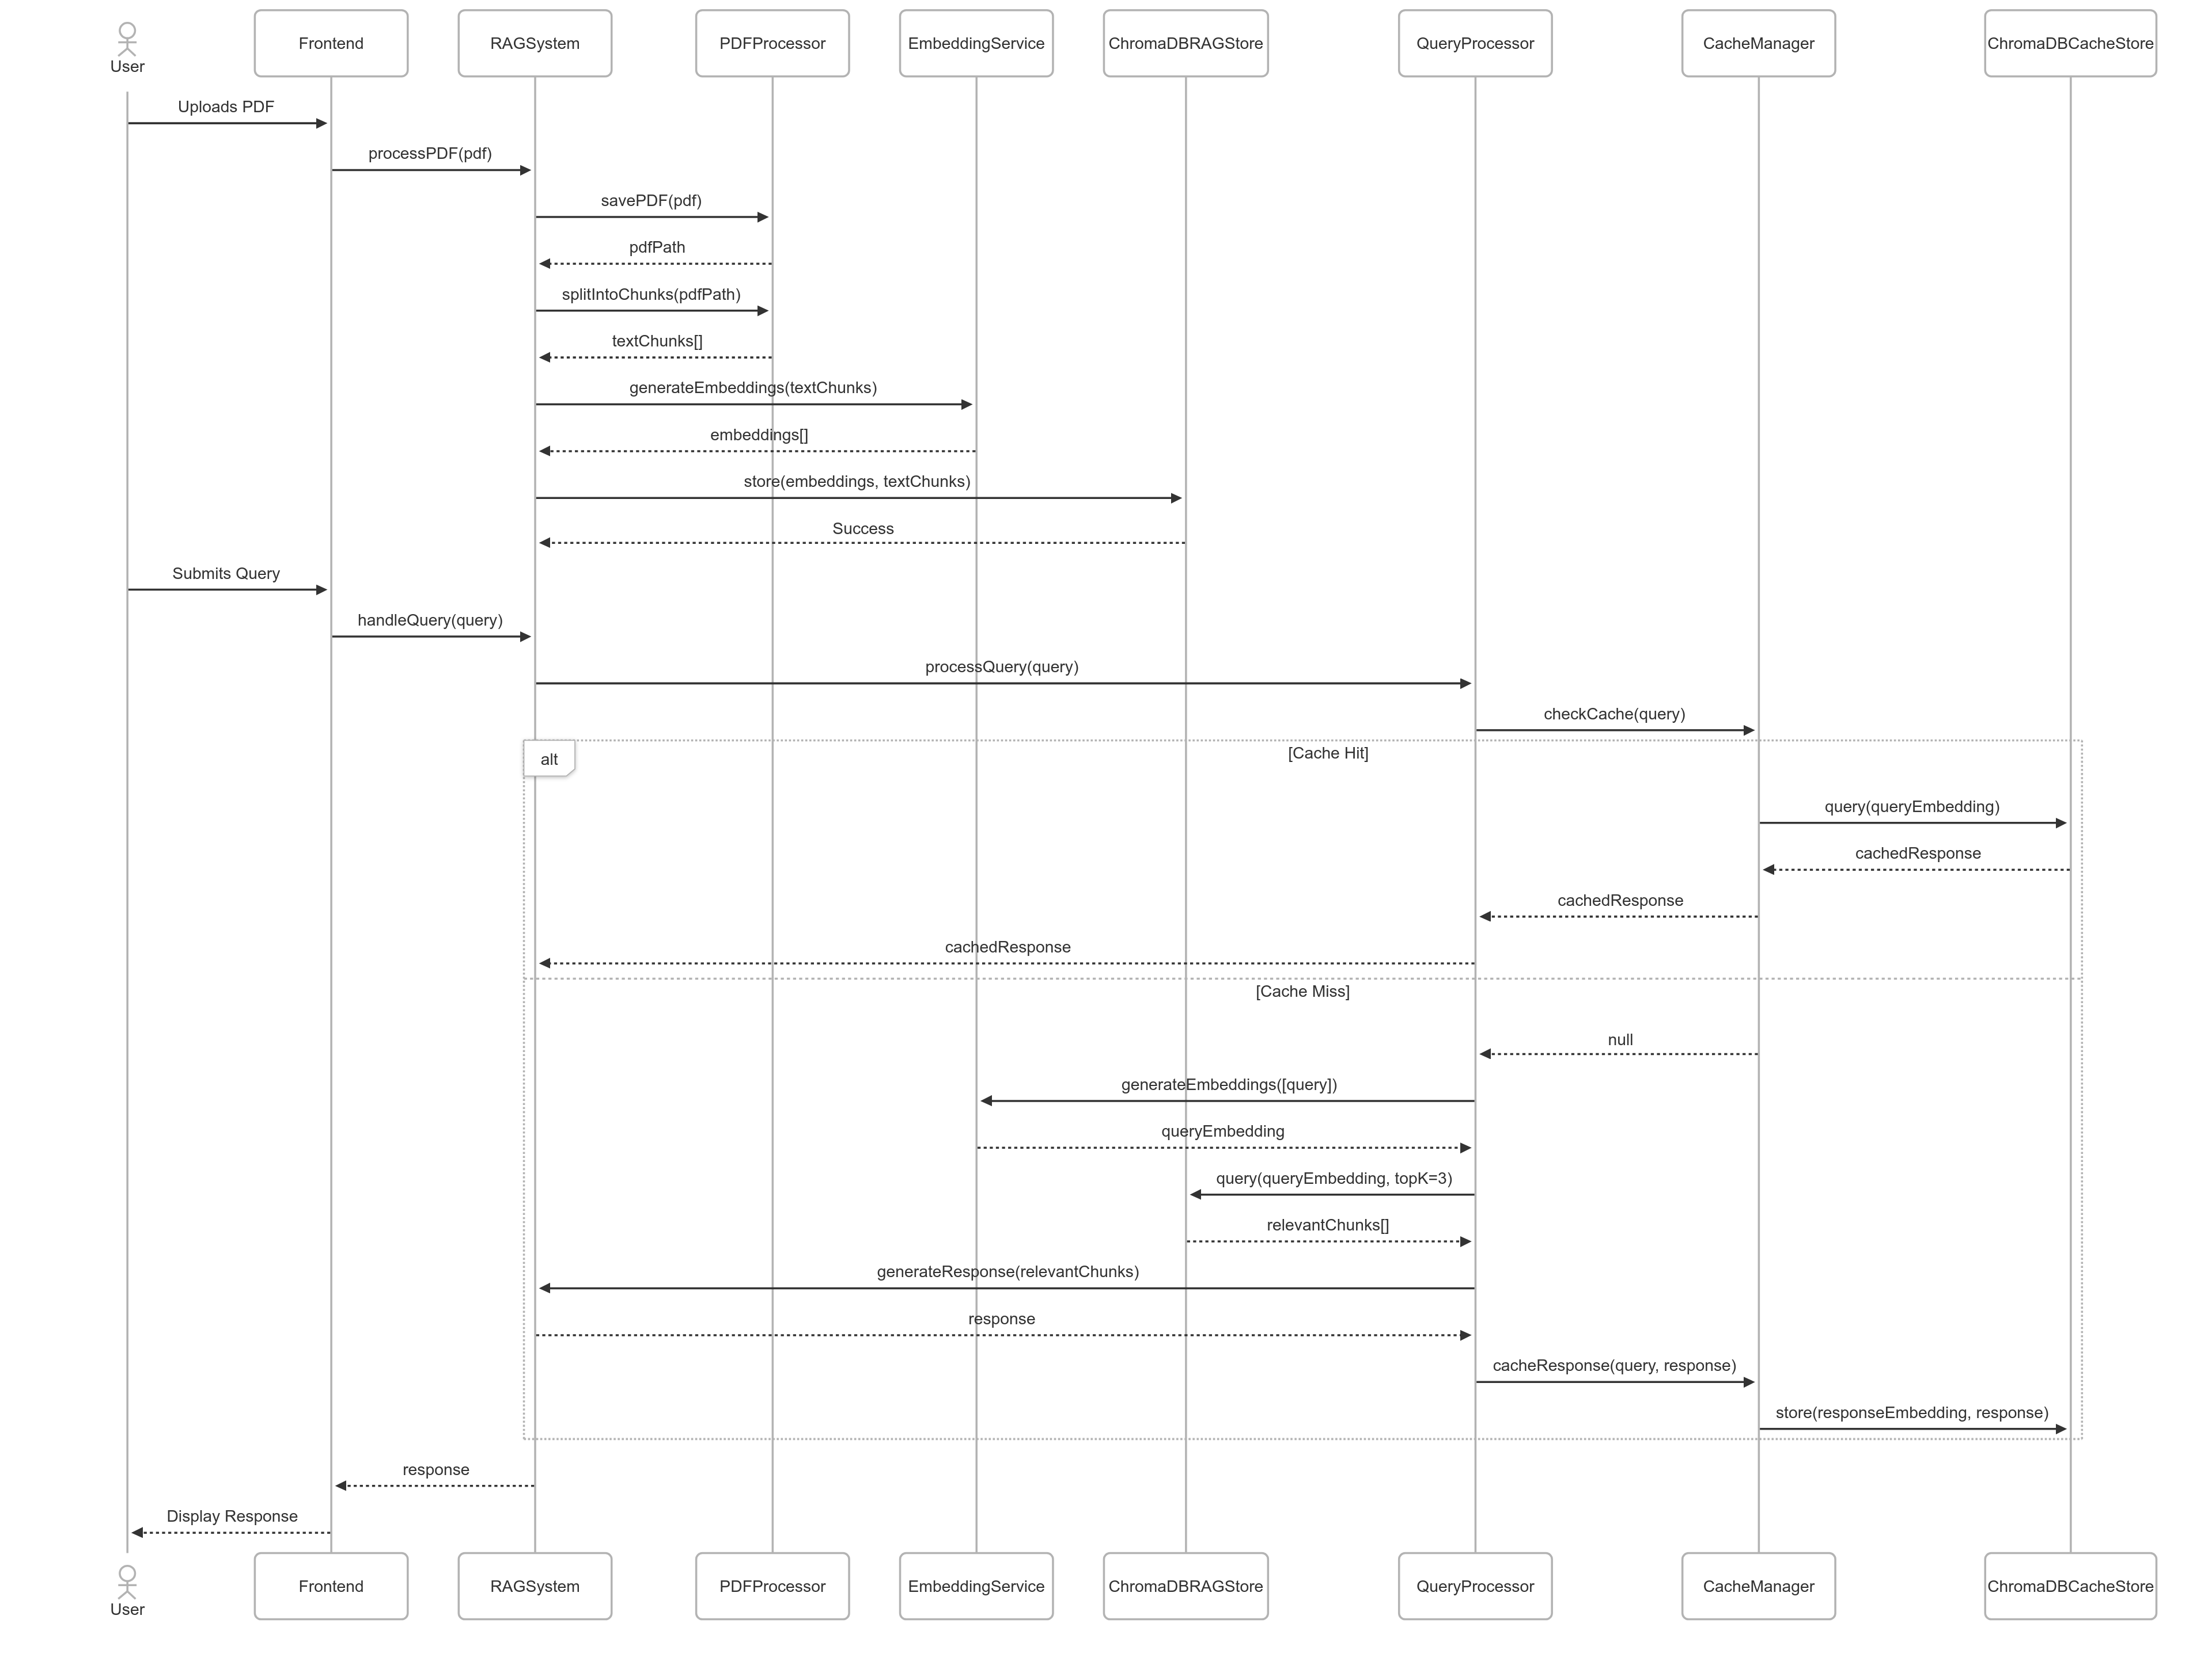
UML DIAGRAMS
Sequence Diagram: A sequence diagram in Unified Modelling Language (UML) is a kind of interaction diagram that shows how processes operate with one another and in what order. It is a construct of a Message Sequence Chart. Sequence diagrams are sometimes called event diagrams, event scenarios, and timing diagrams.
Fig: Sequence Diagram

Slide 27
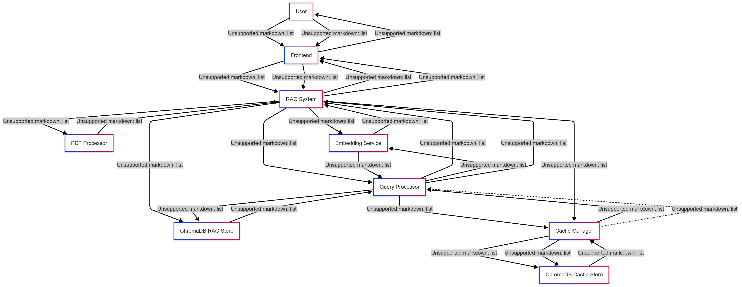
UML DIAGRAMS
Collaboration Diagram:
In collaboration diagram the method call sequence is indicated by some numbering technique as shown below. The number indicates how the methods are called one after another. We have taken the same order management system to describe the collaboration diagram. The method calls are similar to that of a sequence diagram. But the difference is that the sequence diagram does not describe the object organization whereas the collaboration diagram shows the object organization.
Fig: Collaboration Diagram

Slide 28
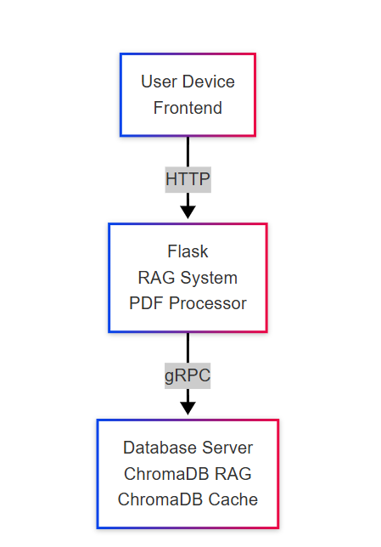
UML DIAGRAMS
Deployment Diagram
Deployment diagram represents the deployment view of a system. It is related to the component diagram. Because the components are deployed using the deployment diagrams. A deployment diagram consists of nodes. Nodes are nothing but physical hardware’s used to deploy the application.

Slide 29
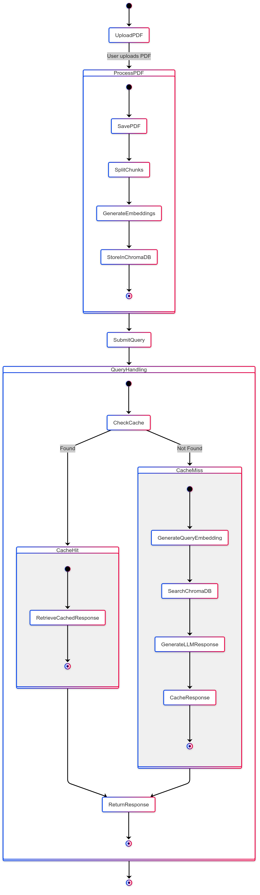
UML DIAGRAMS
Activity Diagram:
Activity diagrams are graphical representations of workflows of stepwise activities and actions with support for choice, iteration and concurrency. In the Unified Modelling Language, activity diagrams can be used to describe the business and operational step-by-step workflows of components in a system. An activity diagram shows the overall flow of control.
Fig: Activity Diagram

Slide 30
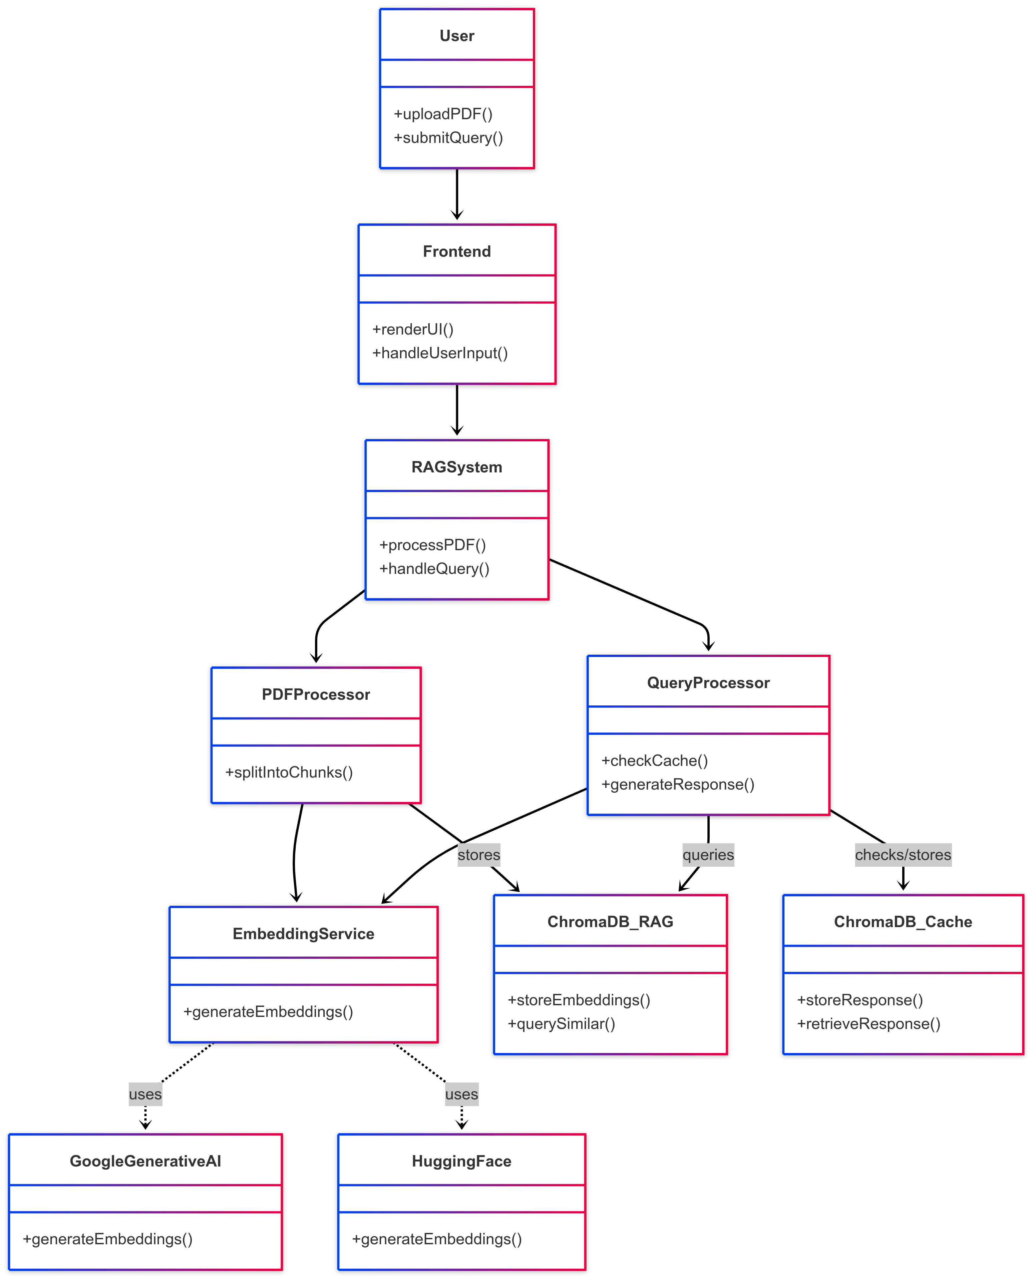
UML DIAGRAMS
Component Diagram:
A component diagram, also known as a UML component diagram, describes the organization and wiring of the physical components in a system. Component diagrams are often drawn to help model implementation details and double-check that every aspect of the system's required functions is covered by planned development.

Slide 31
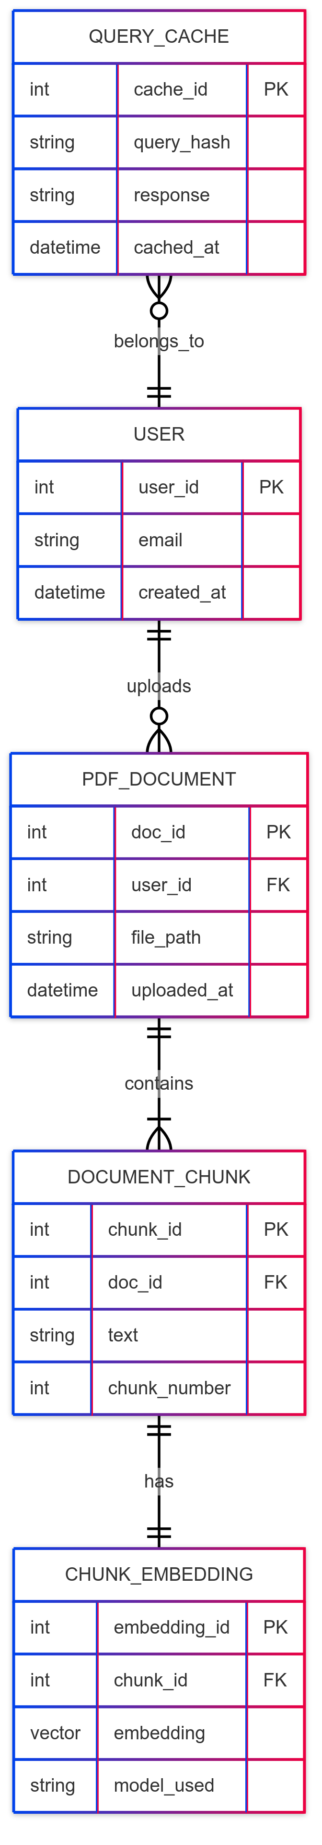
UML DIAGRAMS
ER Diagram: An Entity–relationship model (ER model) describes the structure of a database with the help of a diagram, which is known as Entity Relationship Diagram (ER Diagram). An ER model is a design or blueprint of a database that can later be implemented as a database. The main components of E-R model are: entity set and relationship set. An ER diagram shows the relationship among entity sets. An entity set is a group of similar entities and these entities can have attributes. In terms of DBMS, an entity is a table or attribute of a table in database, so by showing relationship among tables and their attributes, ER diagram shows the complete logical structure of a database. Let’s have a look at a simple ER diagram to understand this concept.

Slide 32
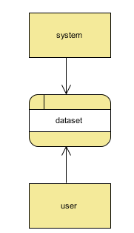
UML DIAGRAMS
DFD Diagram: A Data Flow Diagram (DFD) is a traditional way to visualize the information flows within a system. A neat and clear DFD can depict a good amount of the system requirements graphically. It can be manual, automated, or a combination of both. It shows how information enters and leaves the system, what changes the information and where information is stored. The purpose of a DFD is to show the scope and boundaries of a system as a whole. It may be used as a communications tool between a systems analyst and any person who plays a part in the system that acts as the starting point for redesigning a system.
Fig: Context level Diagram

Slide 33
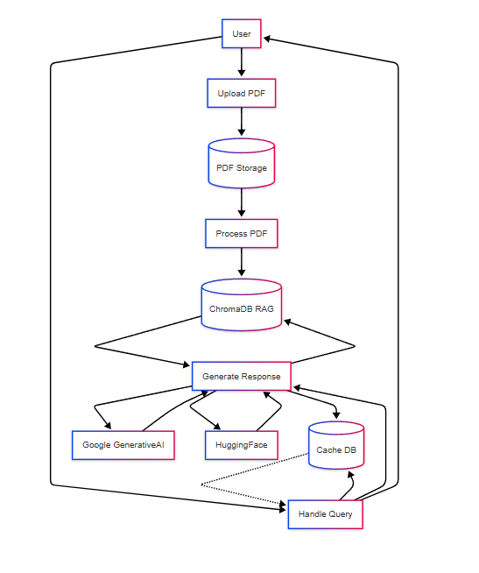
UML DIAGRAMS
FigureLevel-1 diagram

Slide 34
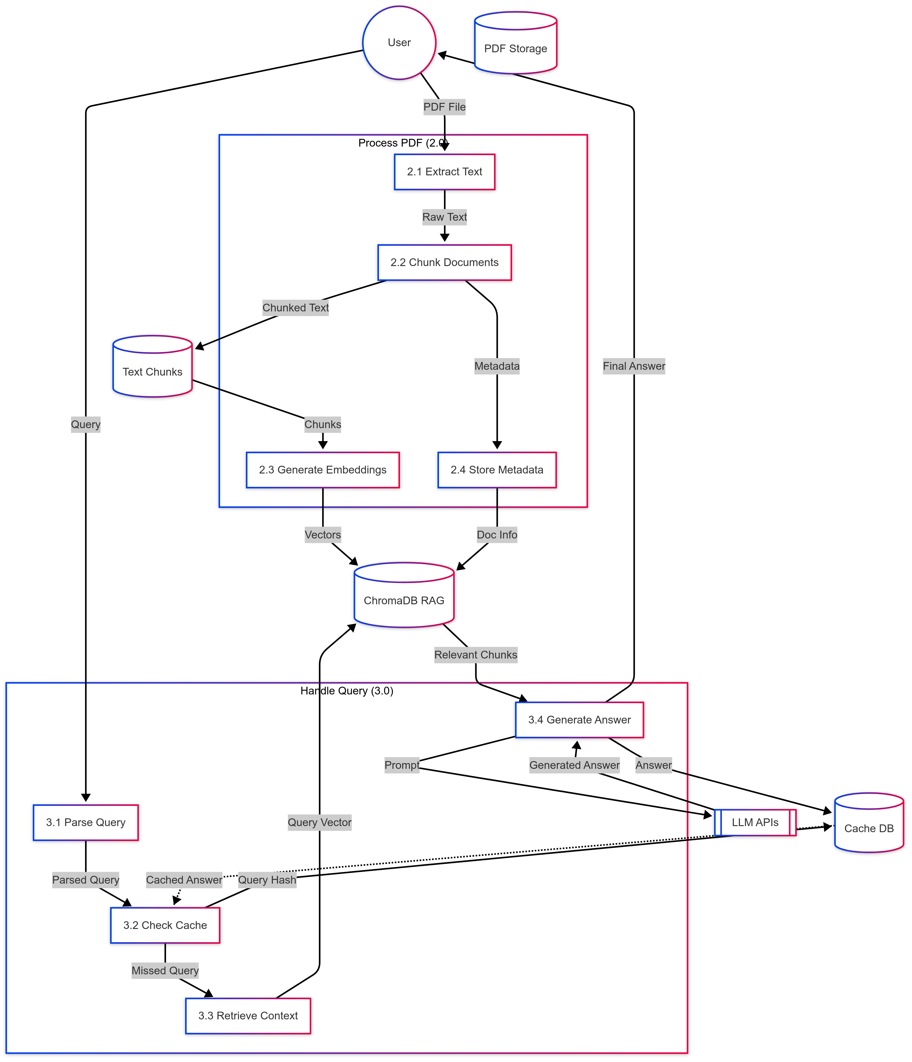
UML DIAGRAMS
Figure:Level-2 diagram

Slide 35
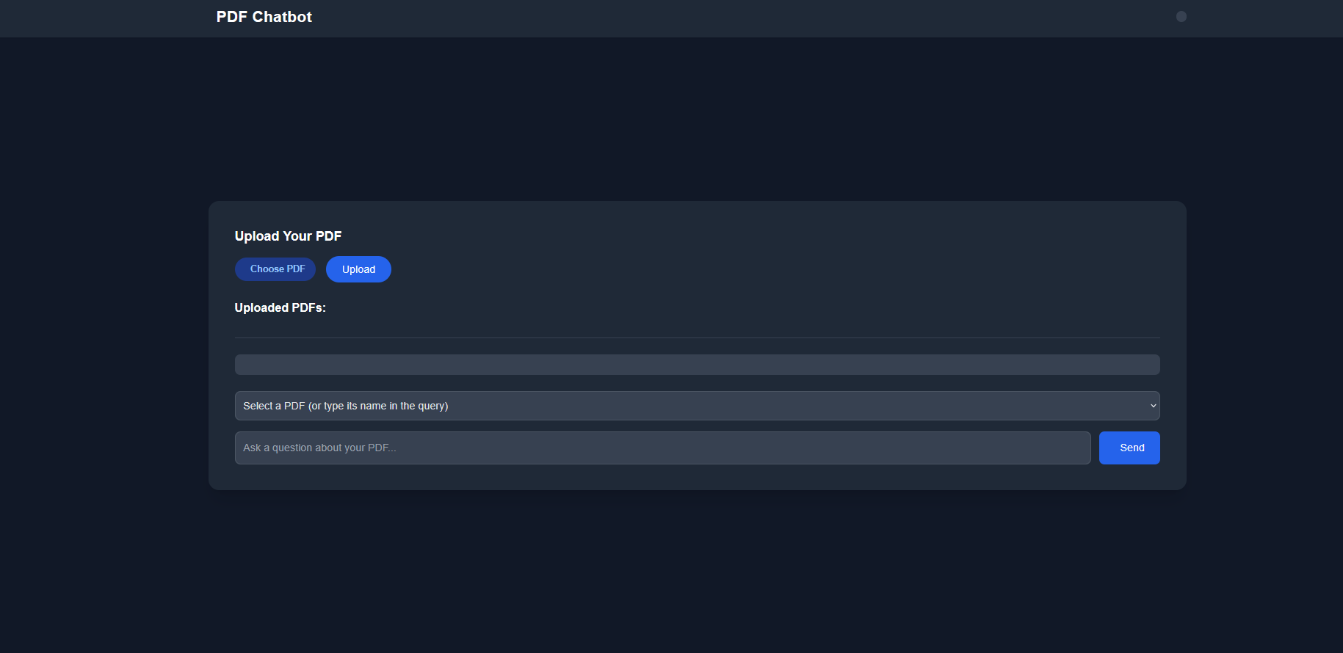
OUTPUT SCREENS
INDEX PAGE:
Here appears a minimalistic, dark-themed interface for the PDF Chatbot UI with options to upload and work with PDF documents.
It encompasses choosing and uploading a PDF, selecting an uploaded PDF file, and inputting questions related to the document in a chatbot-style manner.

Slide 36
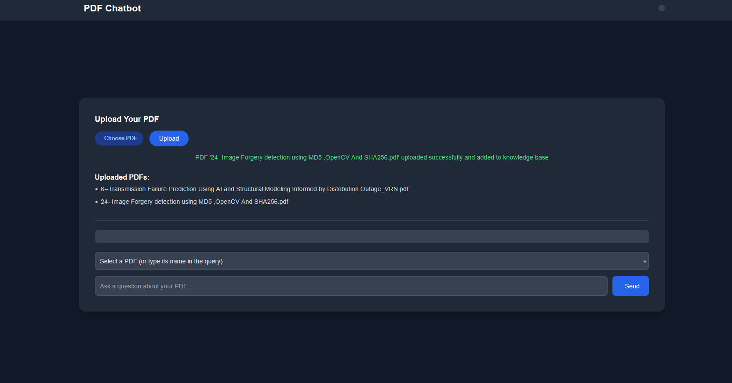
OUTPUT SCREENS
• The option is given to the user to select one of the uploaded PDFs and to enter a particular question pertaining to its content.
• A dropdown allows switching between uploaded files. Meanwhile, the question field permits contextual queries, allowing for greater usability.

Slide 37
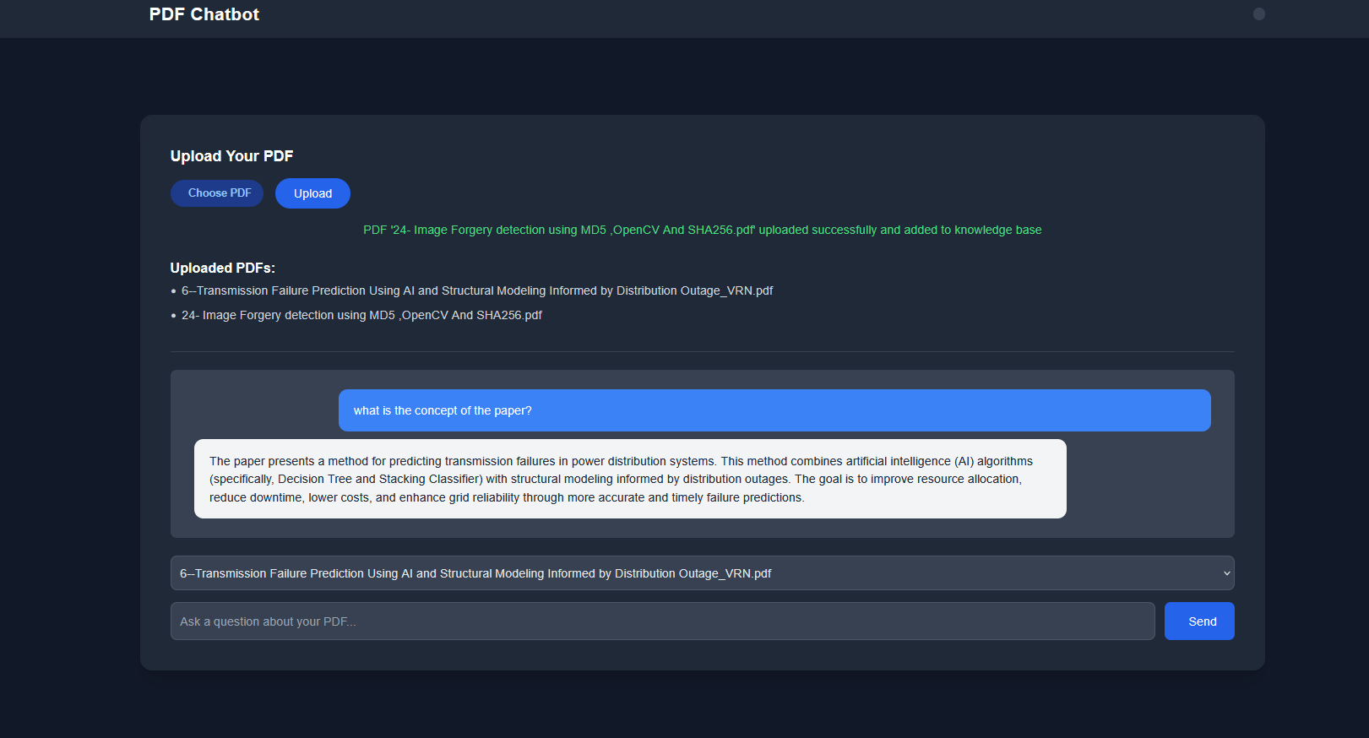
OUTPUT SCREENS
The PDF Chatbot interface has a dark theme. There is an upload section for PDF files and an area for chatting. The uploaded document bears the title "6-Transmission Failure Prediction using AI and Structural Modeling informed by Distribution Outages_VEER.pdf." A user query on the concept of a paper is posed, while the feedback explains the prediction of transmission failures in power distribution systems using AI and structural modeling.

Slide 38
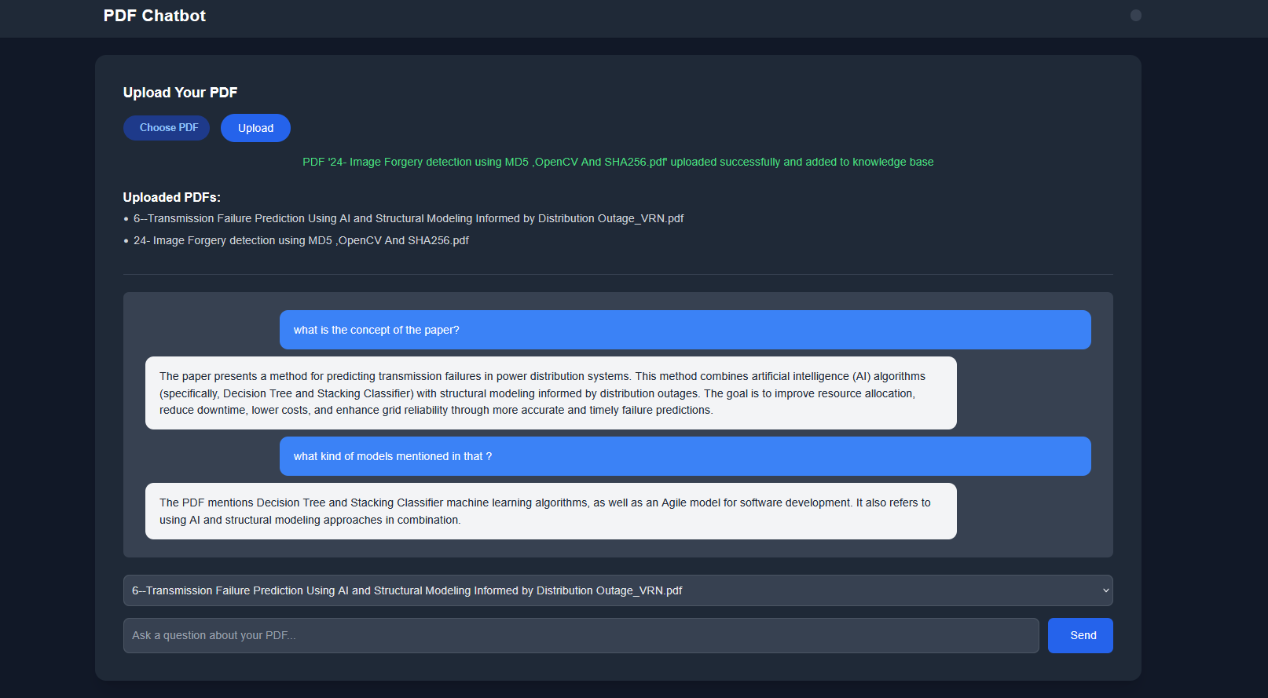
OUTPUT SCREENS
There is in the PDF Chatbot interface an uploaded document called "6-Transmission Failure Prediction using AI and Structural Modeling informed by Distribution Outages_VEER.pdf." There is an ongoing conversation with user queries about the paper's concept and the models, which are answered through options of AI and structural modeling.

Slide 39
CONCLUSION
This study implemented and then assessed a PDF Knowledge Extraction System that efficiently retrieves semantic content in order to generate precise answers to user queries. The main objectives of the study were:
The design and implementation of a system for knowledge extraction from documents in a structured and semantic way.
Real-time document retrieval and question-answering evaluation of CAG and RAG models.
User experience studies of the system, primarily usability, and accuracy. The findings from the research show that the CAG model increases the efficiency of the system as it reduces the response time for repeated queries.
In real terms, the system accomplished very good cache hit rates, hence making speed and responsiveness of user interaction extremely important for frequent document retrieval. User feedback communes to the usability aspect of the system, with very high satisfaction ratings and positive comments on the accuracy of answers generated.
The study contributes to the current body of knowledge by operationalizing embedding-based semantic retrieval and integration of CAG and RAG models for knowledge extraction from documents. The results also show the growing importance that semantic models will gain in future question-answering systems compared to classical keyword-based approaches.

Slide 40
FUTURE ENHANCEMENT
Multi-Part and Complex Queries: This study could be extended for multi-turn conversation-based scenarios and for questions/issues for multi-part answering, such that the system should work for queries involving referring to multiple sections of documents or to synthesize information from various sources.
Advanced AI Techniques: The system might use advanced-level AI methods, including query optimization using reinforcement learning, thus rendering it an adaptive system whose performance will be enhanced with time as it starts learning from human interactions and preferences.
Cross-Domain Knowledge Extraction: Vastly more versatile and useful by extending domain coverage (e.g., legal, medical, scientific documents); a domain-adaptive model can be hypothesized to assist in realizing domain-specific vocabulary and query types.

Slide 41
REFERENCES
I. Constantino, S. Kojaku, S. Fortunato, and Y.-Y. Ahn, “Representing the disciplinary structure of physics: A comparative evaluation of graph and text embedding methods,” Quantitative Science Studies, vol. 6, pp. 263–280, Mar. 2025, doi: 10.1162/QSS_A_00349.
[2] J. Pennington, R. Socher, and C. D. Manning, “GloVe: Global vectors for word representation,” EMNLP 2014 - 2014 Conference on Empirical Methods in Natural Language Processing, Proceedings of the Conference, pp. 1532–1543, 2014, doi: 10.3115/V1/D14-1162.
[3] D. Cer, M. Diab, E. Agirre, I. Lopez-Gazpio, and L. Specia, “SemEval-2017 Task 1: Semantic Textual Similarity Multilingual and Cross-lingual Focused Evaluation,” Proceedings of the Annual Meeting of the Association for Computational Linguistics, pp. 1–14, 2017, doi: 10.18653/v1/s17-2001.
[4] C. Raffel et al., “Exploring the Limits of Transfer Learning with a Unified Text-to-Text Transformer,” Journal of Machine Learning Research, vol. 21, pp. 1–67, Oct. 2019, Accessed: Jun. 02, 2025. [Online]. Available: https://arxiv.org/abs/1910.10683v4

Slide 42
REFERENCES
[5] V. Moskvoretskii et al., “Adaptive Retrieval Without Self-Knowledge? Bringing Uncertainty Back Home,” Jan. 2025, Accessed: Jun. 02, 2025. [Online]. Available: http://arxiv.org/abs/2501.12835
[6] G. Salton, A. Wong, and C. S. Yang, “A vector space model for automatic indexing,” Commun ACM, vol. 18, no. 11, pp. 613–620, Nov. 1975, doi: 10.1145/361219.361220.
[7] Z. Jing, Y. Su, and Y. Han, “When Large Language Models Meet Vector Databases: A Survey,” 2025 Conference on Artificial Intelligence x Multimedia (AIxMM), pp. 7–13, Feb. 2025, doi: 10.1109/AIXMM62960.2025.00008.
[8] V. K. Kommineni, B. König-Ries, and S. Samuel, “Harnessing multiple LLMs for Information Retrieval: A case study on Deep Learning methodologies in Biodiversity publications,” Nov. 2024, Accessed: Jun. 02, 2025. [Online]. Available: http://arxiv.org/abs/2411.09269
[9] R. A. Advisor and H. Kumar, “Enhancing Cache-Augmented Generation (CAG) with Adaptive Contextual Compression for Scalable Knowledge Integration,” May 2025, Accessed: Jun. 02, 2025. [Online]. Available: https://arxiv.org/abs/2505.08261v1

